Slide 1
Team Wranglers Hey there, do you need a car?
Ideation, Data Collection, Analysis and Results

Slide 2



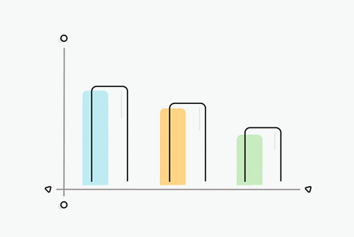
The Implementation
The Idea
Many international students come to the US every year for education
Most use public transportation until events like internship, lifestyle, residential changes
Use individual’s location history to analyze travel behavior and draw insights
Algorithm will provide a dashboard view of:
Distance travelled
Time spent in travelling
Frequent trips
Hypothetical time saved with car
Assist in making informed decision about the need for car purchase
Data Extraction
Data Transformation
Pattern Analysis
Result Evaluation
Report Generation

Slide 3
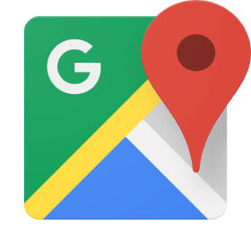



Data Extraction
Data Transformation
Pattern Analysis
Result Evaluation
Report Generation
Type of data:
Size of data:
300+ MB per user
Extracted via:
Stored format:
Converted format:

Slide 4
Data Extraction
Data Transformation
Pattern Analysis
Result Evaluation
Report Generation
Base Features
Derived Features
Goal – To calculate between each pair of timestamps:
Distance travelled
Time interval
Velocity

Slide 5
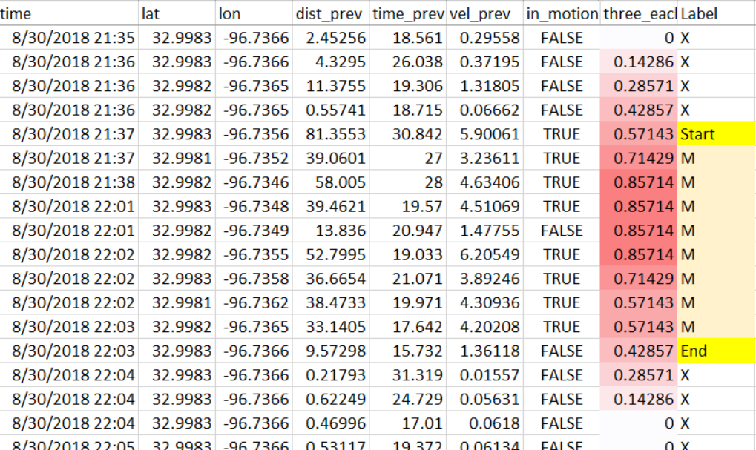
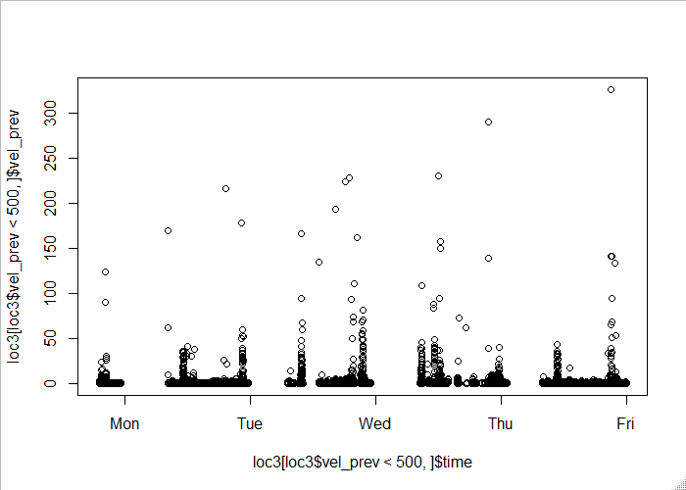
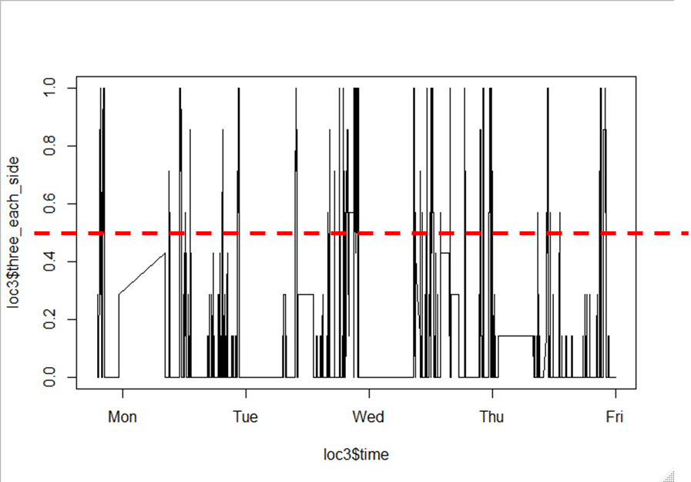
Data Extraction
Data Transformation
Pattern Analysis
Result Evaluation
Report Generation
Pattern Recognition 1
Goal: To identify patterns of motion and rest
Technique: Labeling similar to Named Entity Recognition (Start, Middle, End)
Process:
Use 7 period moving average with bidirectional smoothing
Classify points into Start, Middle and End of journey
Assumption: 1.5 MPH threshold of motion (2 MPH on treadmill at 5’2”)
Noisy Data
Pattern Extraction

Slide 6
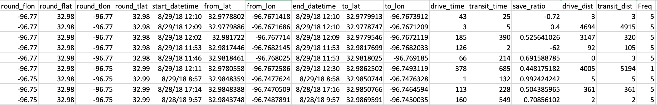
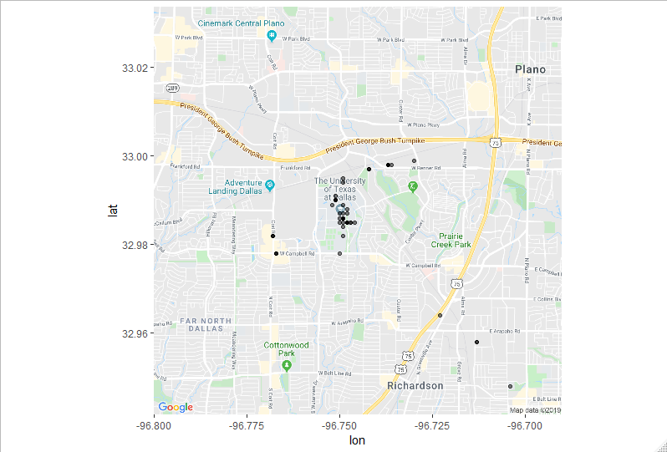
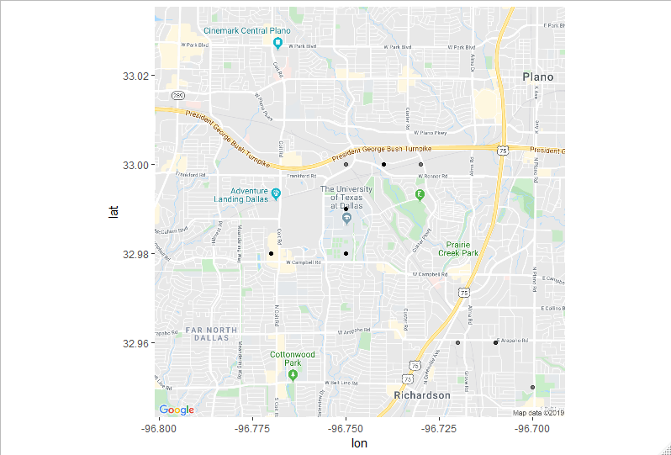
Data Extraction
Data Transformation
Pattern Analysis
Result Evaluation
Report Generation
Pattern Recognition 2
Three Significant Digits
Two Significant Digits
Goal: To identify similar journey patterns in the travel history
Technique: Grouping by rounding latitudes and longitudes
Process: Estimate the geographical resolution based on circumference of Earth and range of longitudes.
Solve as Ω(n) problem by rounding coordinates rather than Ω(n²) for clustering

Slide 7

Applications in the Industry
PI Work
Post-purchase Prediction
Aggregate data for enough individuals and label pre and post purchase period
Customer Engagement and Marketing
Selling insights for marketing purposes
Generate accurate estimate how a person is likely to travel based on pre-purchase behaviors
DART can identify key routes used by UTD students and advertise better
Private Investigators spend weeks drawing frequent routes
Targeted Advertising

Slide 8

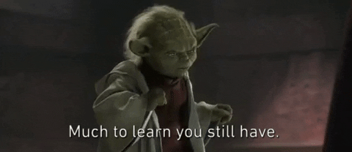



Learnings
Mindset of applying Data Analytics to every walk of life
Use a data-centric approach to processes and to extend the scope to finding more use cases which drive profitability
Exposure to critical but less fancy parts of data analytics, like data wrangling and data cleanup

